Slide 1
Readsboro BF 0102(16)
VT Route 100 Bridge #25 Replacement Project
Readsboro, Vermont Presented by VTrans & VHB
March 21, 2018
© VHB, Inc.

Slide 2
Meeting with you today
Carolyn Carlson
Scott Burbank
Megan Ooms
VTrans Project Manager
VHB Project Manager
VHB Project Engineer

Slide 3
Meeting Overview
Project Objectives
VTrans Project Development Process
Existing Conditions
Proposed Bridge
Traffic Control During Construction
Schedule
Questions

Slide 4
Project Objectives
Coordinated replacement of the bridge
Minimization of disruptions to the public
Minimize impacts to:
Environmental Resources
Historic and Archaeological Resources
Right-Of-Way (ROW)
Utilities

Slide 5
VTrans Project Development Process
Completed
Phase A: Project Definition
Phase B: Project Design
Phase C: Construction – Anticipated Late Spring of 2021
Initiated

Slide 6
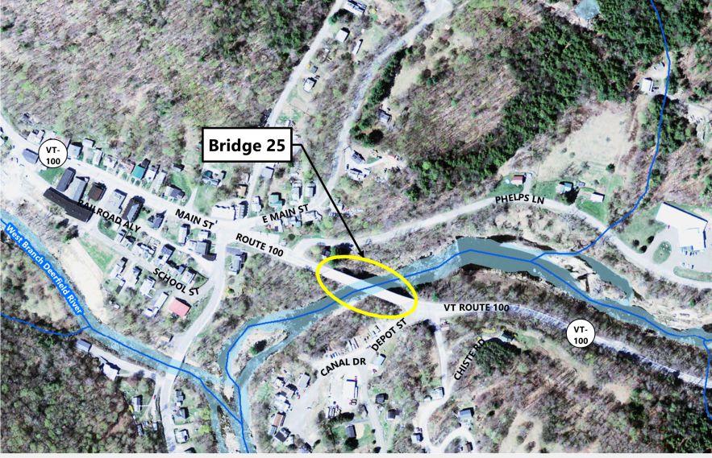
Existing Conditions - Bridge Location
Notes:
Located over Deerfield River
Depot St to the West
Phelps lane and Tunnel St to the East

Slide 7
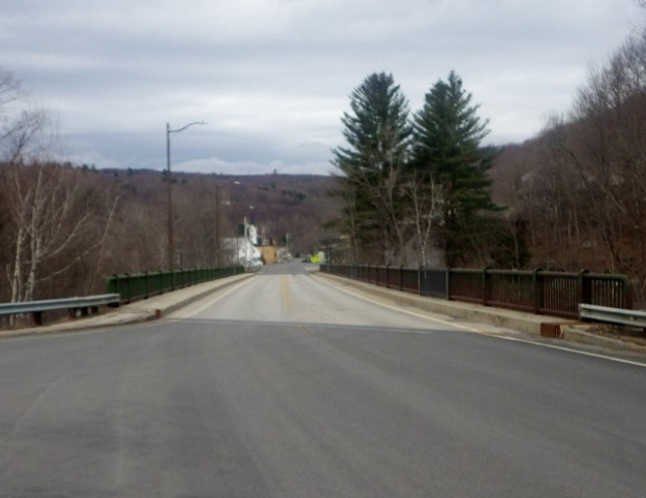
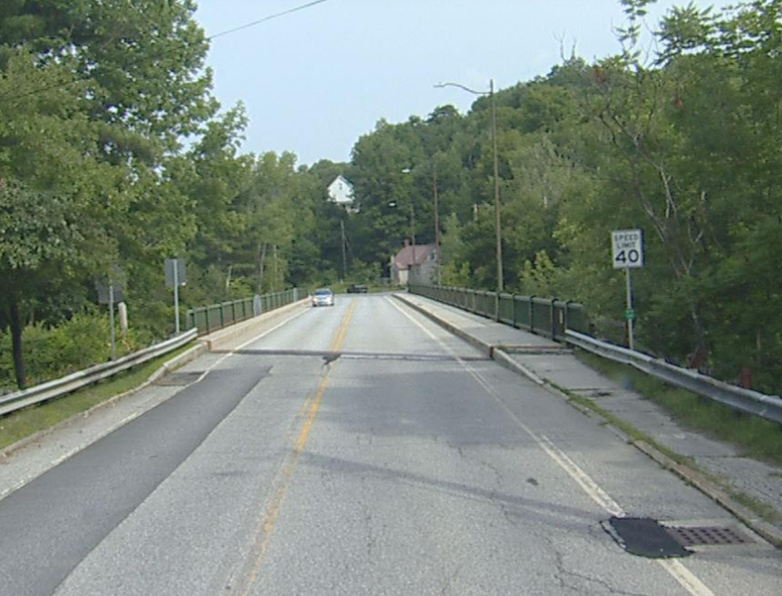
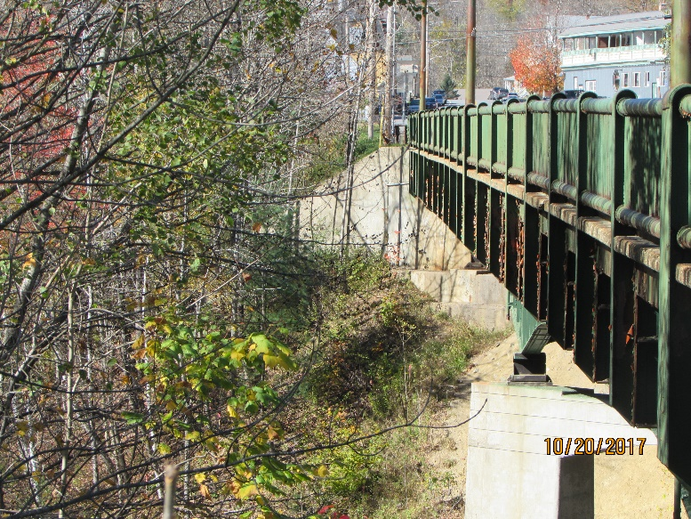
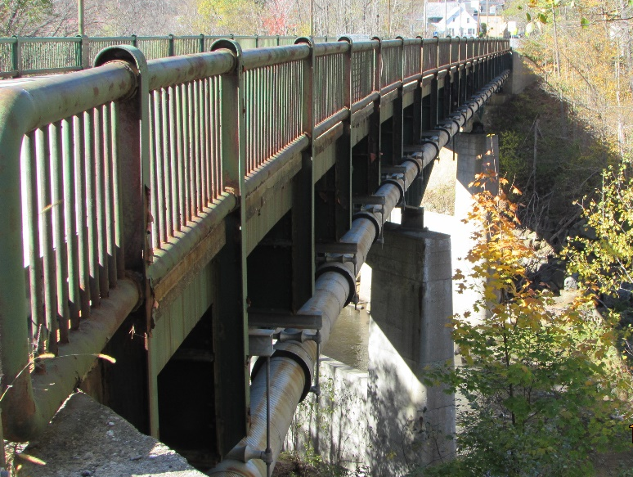
Existing Site Conditions
Notes:
Driving east toward the center of town
Driving west from town
Elevation views of both north and south show deterioration
Waterline on north side can be seen

Slide 8
Existing Site Conditions
340’ Long by 38’-9” Wide Bridge over the Deerfield River
2-105’ spans and 1-130’ span in the middle
Cast-in-place concrete abutments and piers
Curve at the east end
Town roads on either side
Phelps Lane to the west
Depot Street to the east
From last Inspection performed in 2017:
Deck: 3 (Serious)
Superstructure: 4 (Poor)
Substructure: 6 (Satisfactory)

Slide 9
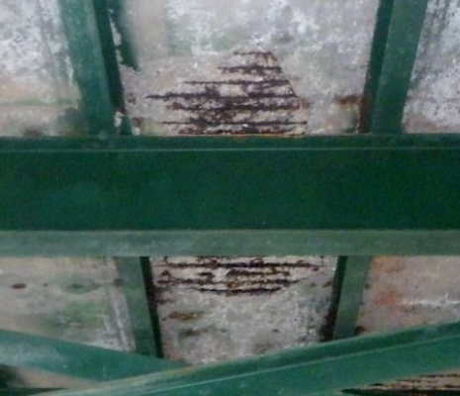
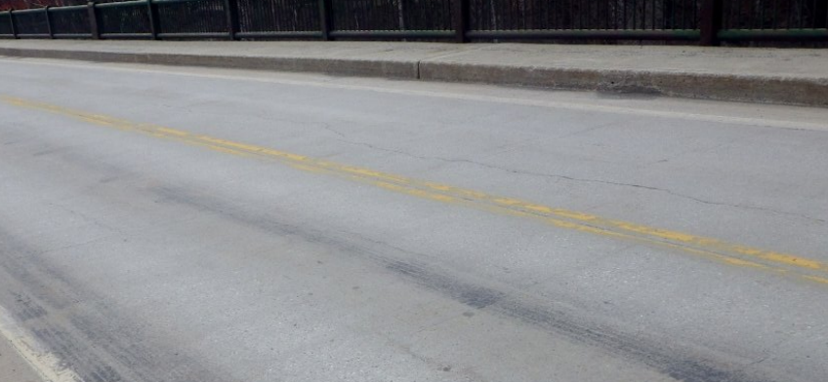
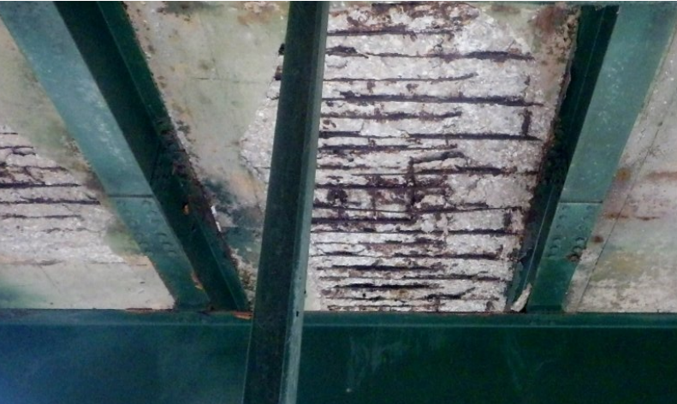
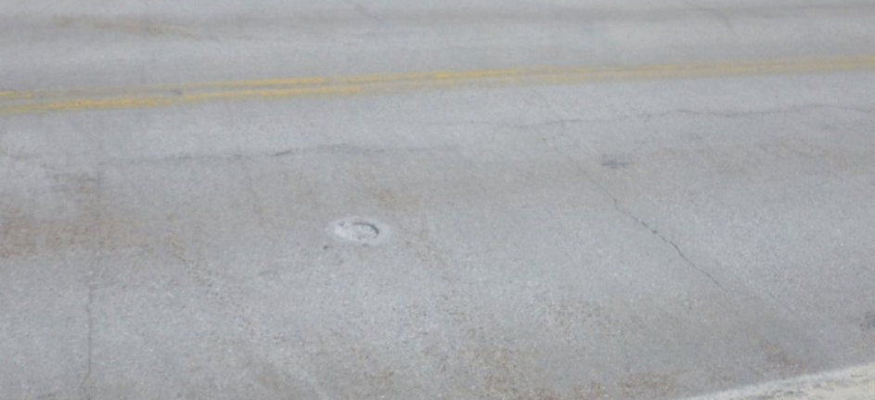
Existing Site Conditions: Deck
Notes:
Here you can see some examples of why the deck is rated a 3 for serious condition
The underside of the deck exhibits concrete spalling and rusting and deteriorating reinforcement
The topside of the deck shows both longitudinal and transverse cracking as well as general wear of the surface. Cracking is prominent throughout the length of the deck and will only continue to deteriorate

Slide 10
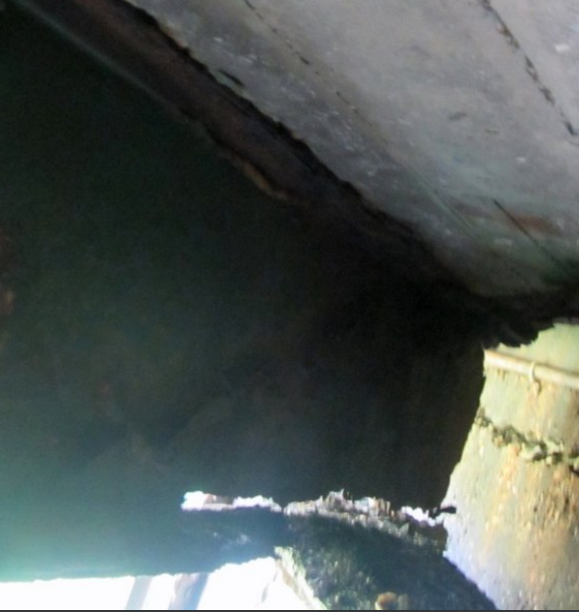
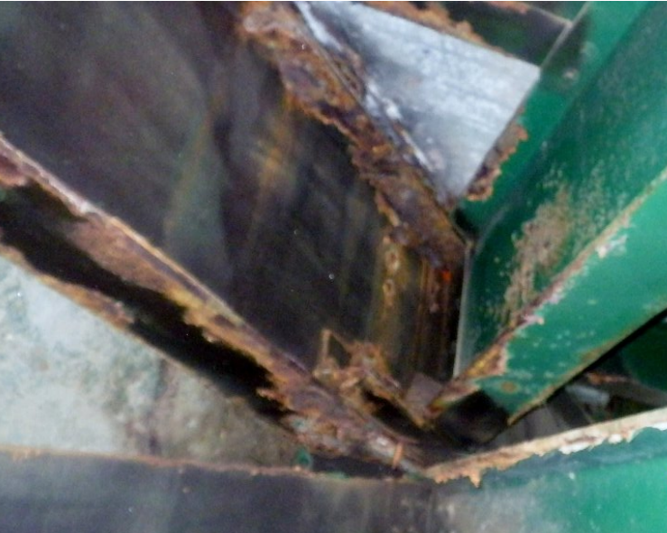
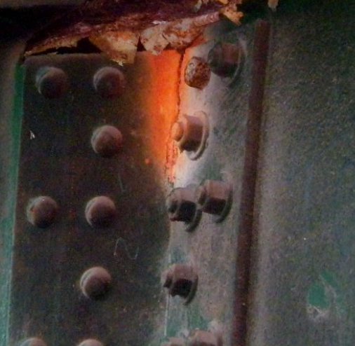
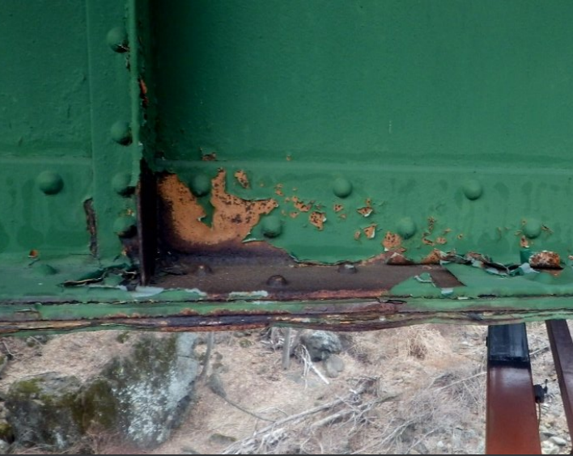
Existing Conditions: Superstructure
Notes:
Here you can see examples of why the superstructure was rater a 4 for Poor condition
The main girder shows severe section loss: full thickness loss
Main bracing members show rusting and section loss
Cracked members are also present including this connection angle which has a crack highlighted in orange.

Slide 11
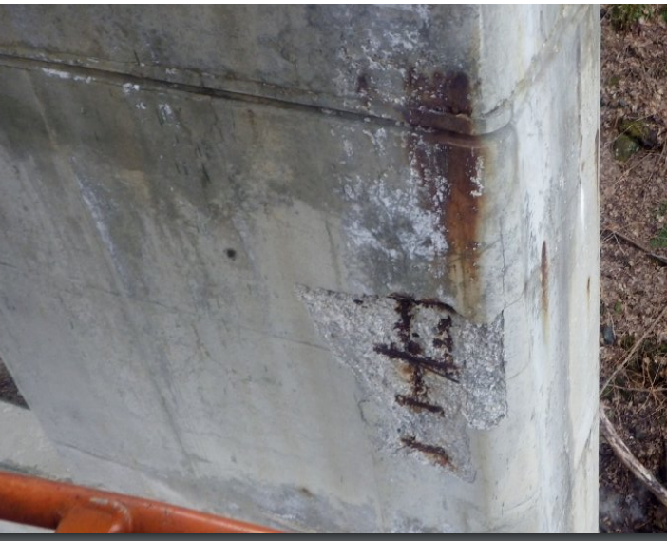
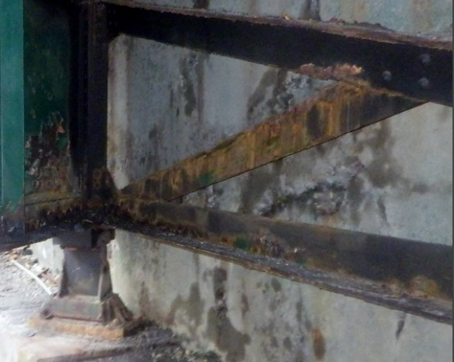
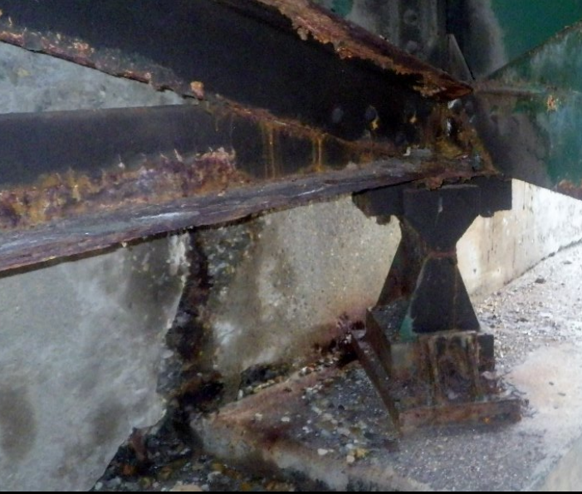
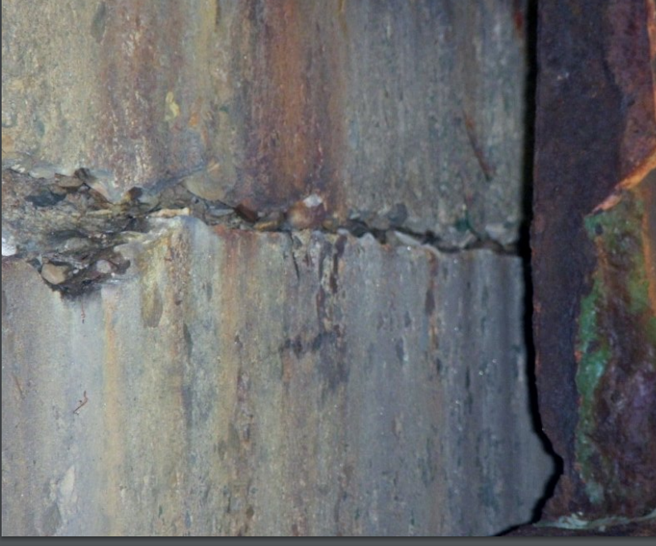
Existing Site Conditions: Substructure
Notes:
The substructure was rated a 6 for Satisfactory but you can see several cracks and concrete spalling throughout the abutments and piers
In several locations the cracks are fairly wide with areas of more significant concrete spalling

Slide 12
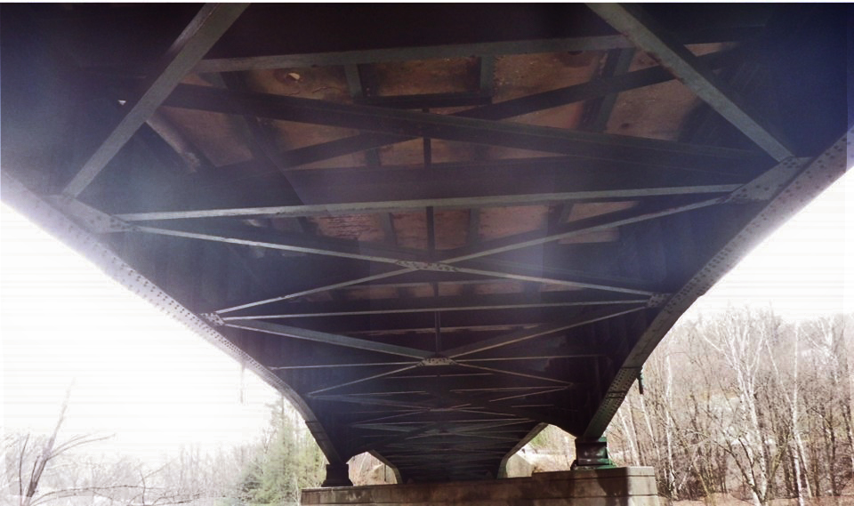
Existing Site Conditions
Fracture Critical Structure
Notes:
Existing bridge is a Fracture Critical Structure
Only 2 Girder System
Loss of 1 Girder leads to Structural Failure
Non-failure critical structures are designed with more than two girders as a redundant system so that the loss of one girder doesn’t lead to entire structure failure for safety reasons.

Slide 13
Proposed Bridge
Design Criteria
Bridge and Roadway Alignment
Curvature Design
Right-of-Way Impacts
Design Speed
Scour
Abutting Land Use
Historical/Archaeological Resources
Design Considerations
New Light Poles
Historic Plaque

Slide 14
Proposed Bridge
287’-0” Long by 35’-6” Wide Bridge (33’-6” Rail-to-Rail)
Single span-no piers
Superstructure
Steel Plate Girder Bridge with Concrete Deck
Substructure
Semi-Integral Abutment on Both Sides
Abutment on East is on Ledge
Abutment on West is on piles

Slide 15
Project Limits
Notes:
New Sidewalk from Tunnel St to Depot St.
Coordinating with other sidewalk project planned for the next year
Utility relocations

Slide 16
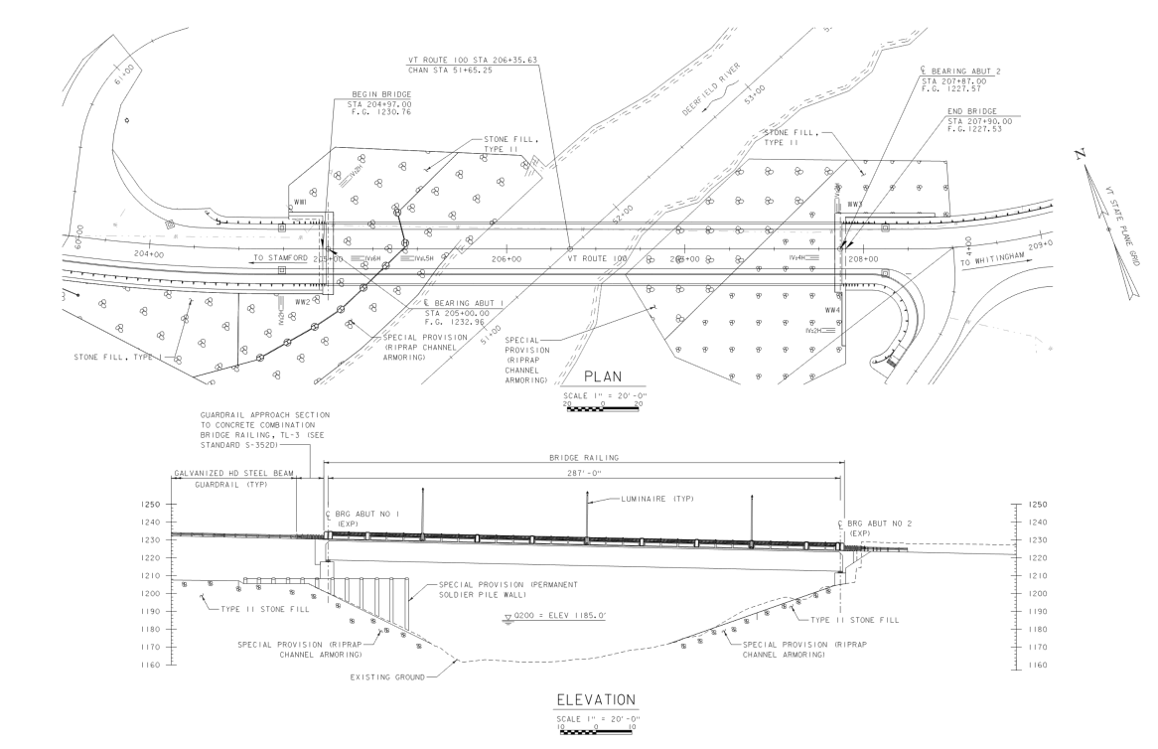
Proposed Bridge

Slide 17
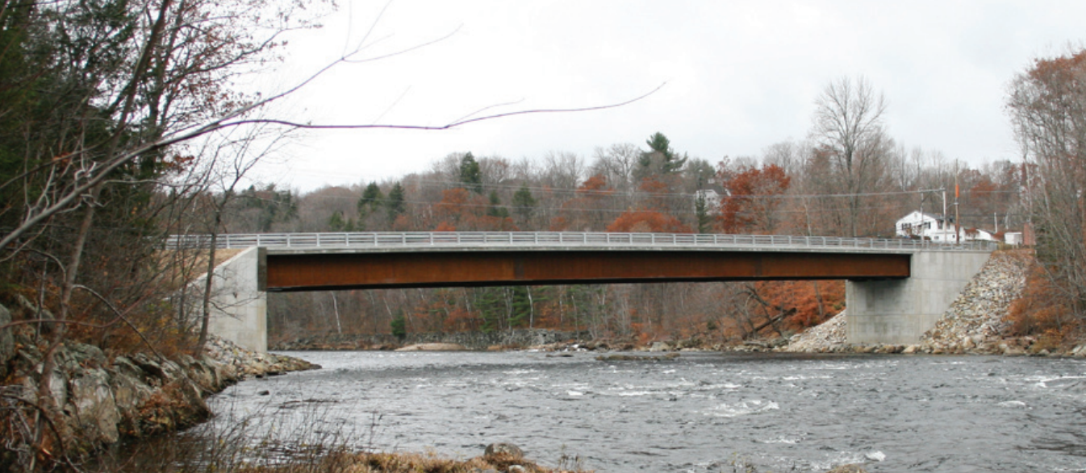
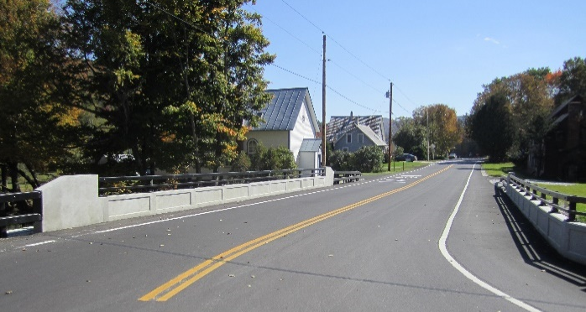
Proposed Bridge
Steel Plate Girder Bridge with Concrete Deck

Slide 18
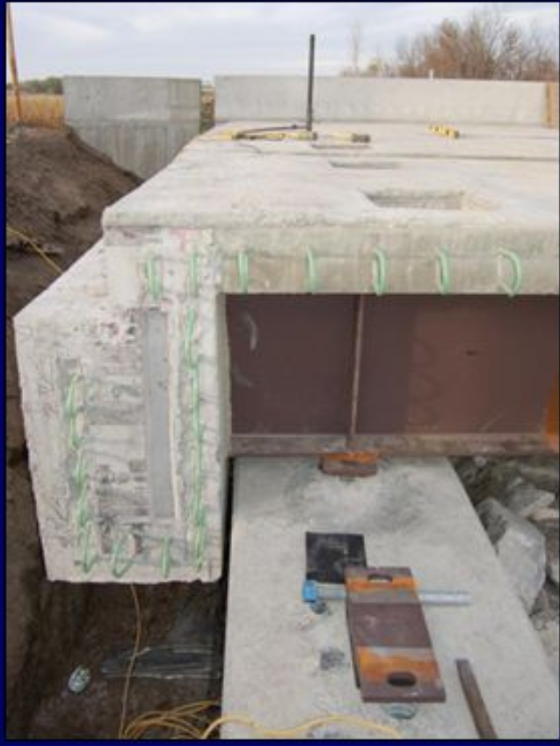
Proposed Bridge
Semi Integral Abutment
(SHRP2 Project R04)

Slide 19
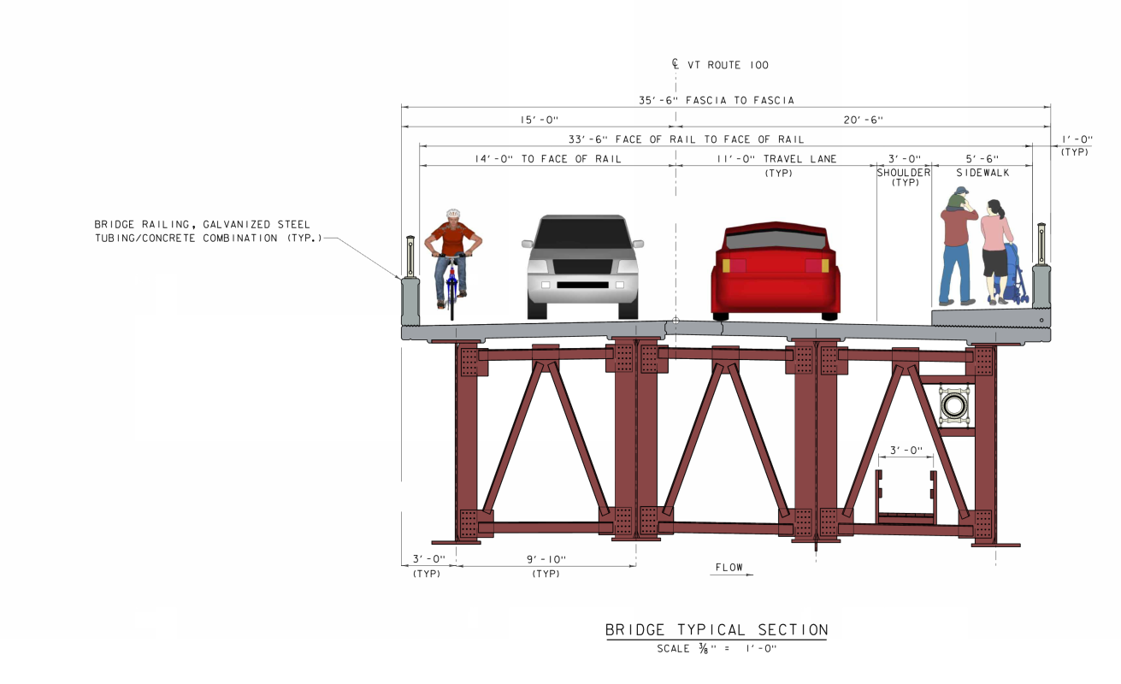
Proposed Bridge
Typical Bridge Section
Notes:
Proposed waterline

Slide 20
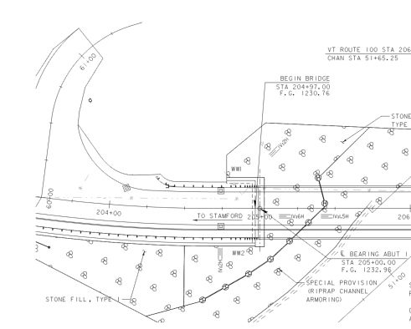
Proposed Bridge- Retaining Walls
Two Types of Retaining Wall Proposed
Pile and Lagging
T-Wall or MSE Wall
Notes:
200+ foot retaining wall
Once the wall type is selected we will get input from the town on aesthetic treatments

Slide 21
T-Wall or MSE Wall

Slide 22
Pile and Lagging Wall

Slide 23
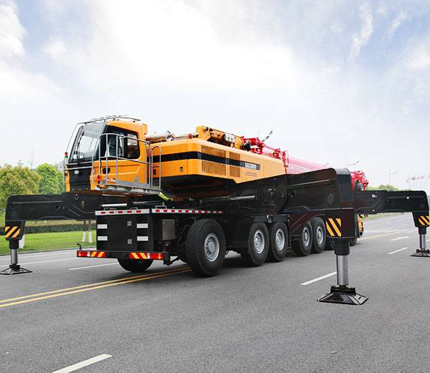
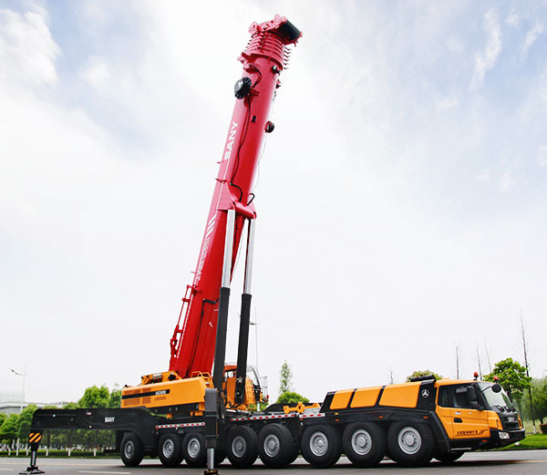
Traffic Control- Overview
Staged Construction Methods
Alternating One-Way Traffic with temporary Traffic Signals
Extended Weekend Closures with Detour
Two Construction Seasons
No Temporary Bridge
Saves Town Money on Waterline Relocation
Temporary Pedestrian Access provided with one-way alternating traffic until Permanent Access is Available

Slide 24
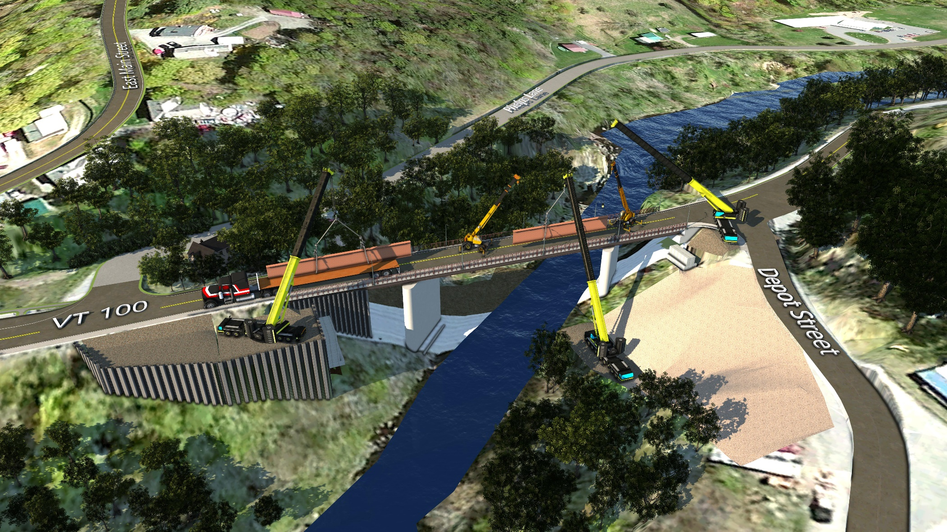
Traffic Control During Construction: PHASE 1A
Notes:
OFF ALIGNMENT
Traffic on existing bridge

Slide 25
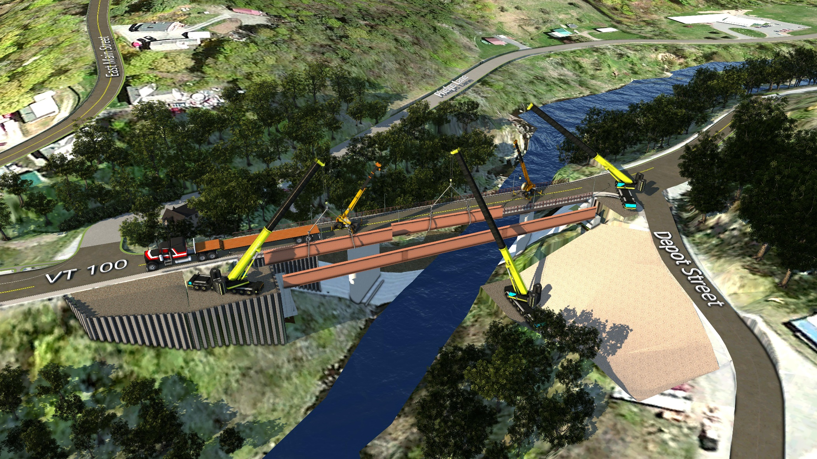
Traffic Control During Construction: PHASE 1B

Slide 26
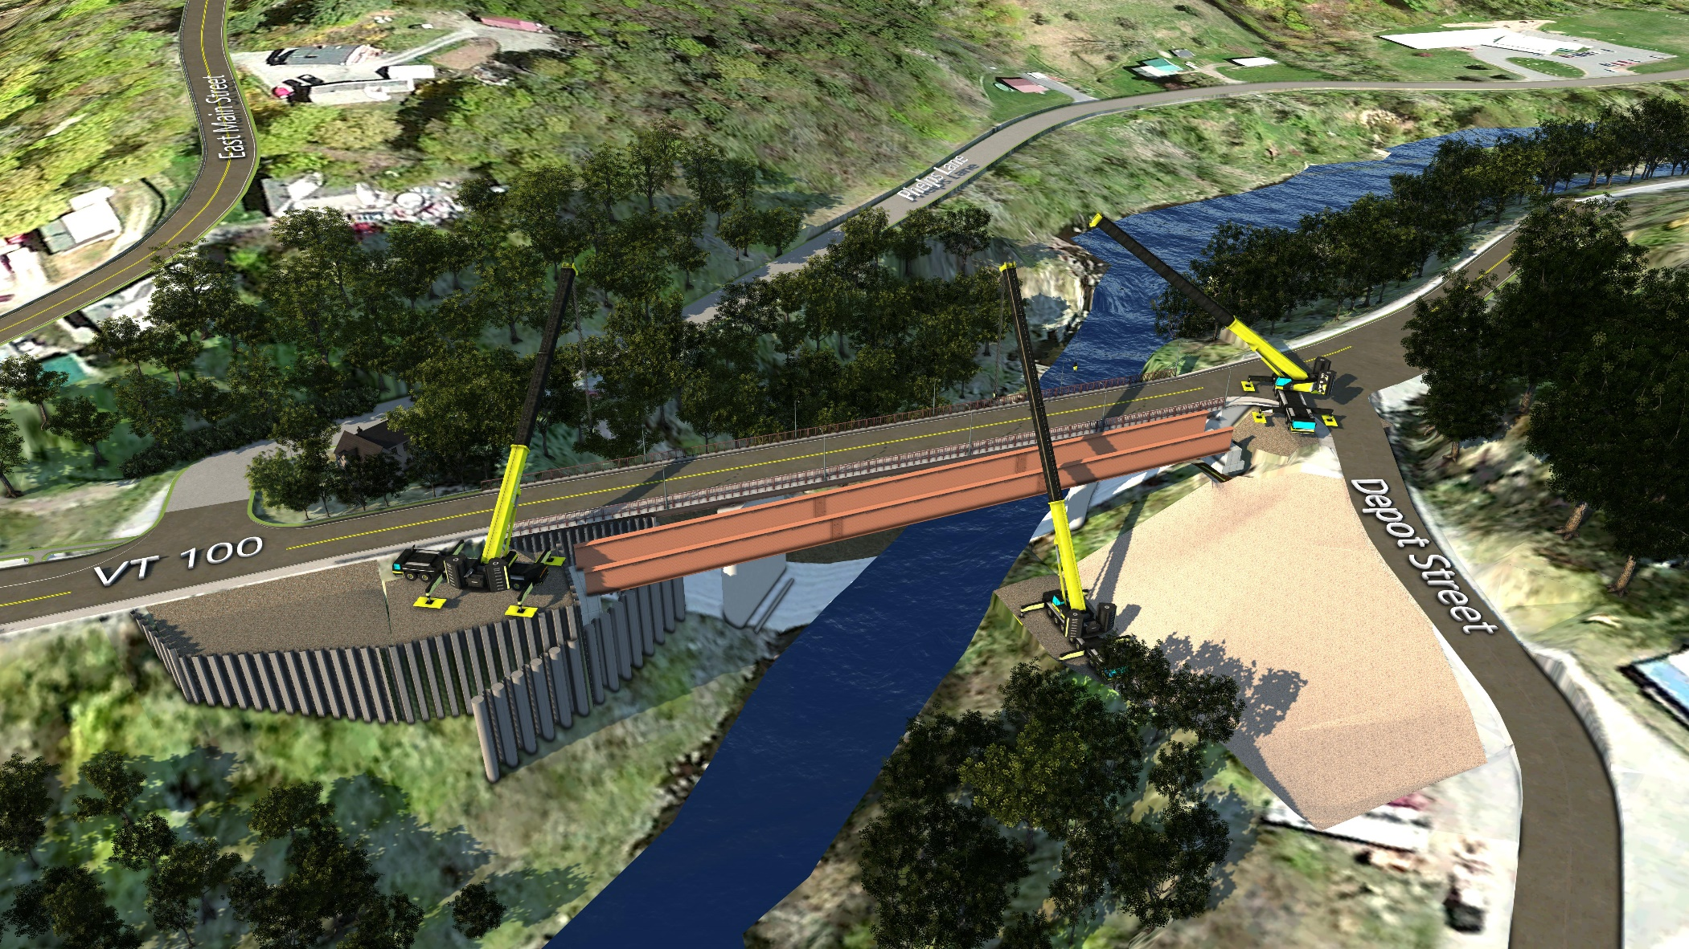
Traffic Control During Construction: PHASE 1B

Slide 27
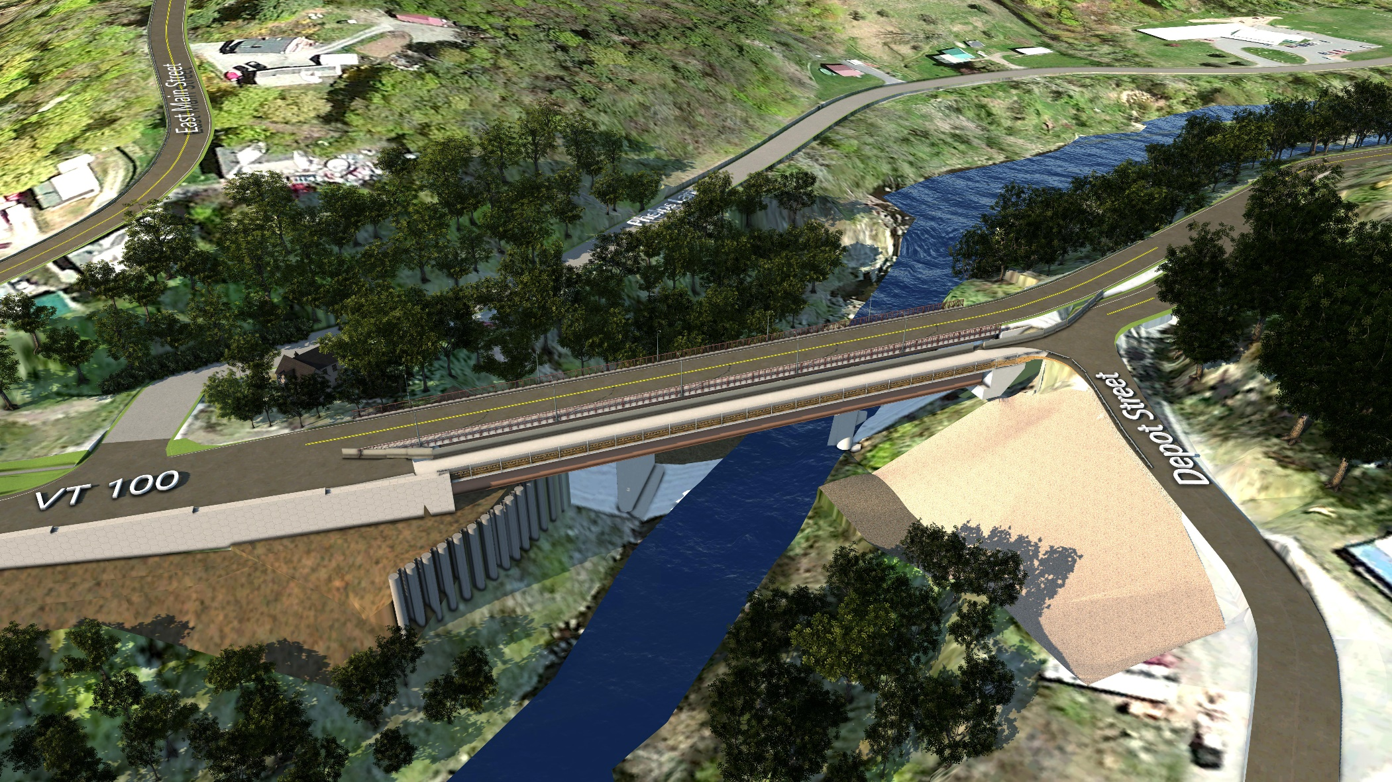
Traffic Control During Construction: PHASE 1B

Slide 28
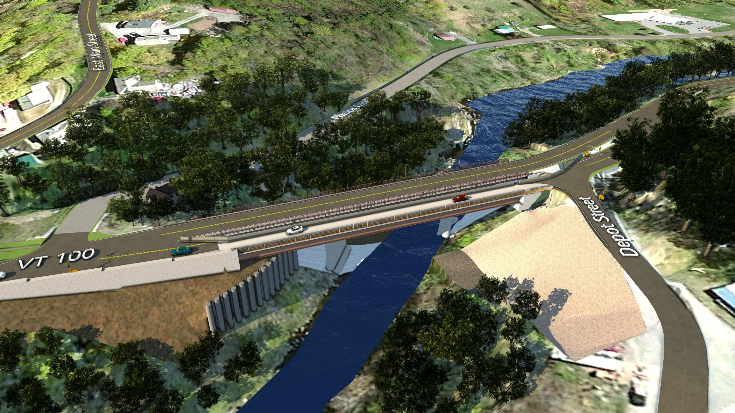
Traffic Control During Construction: PHASE 1B

Slide 29
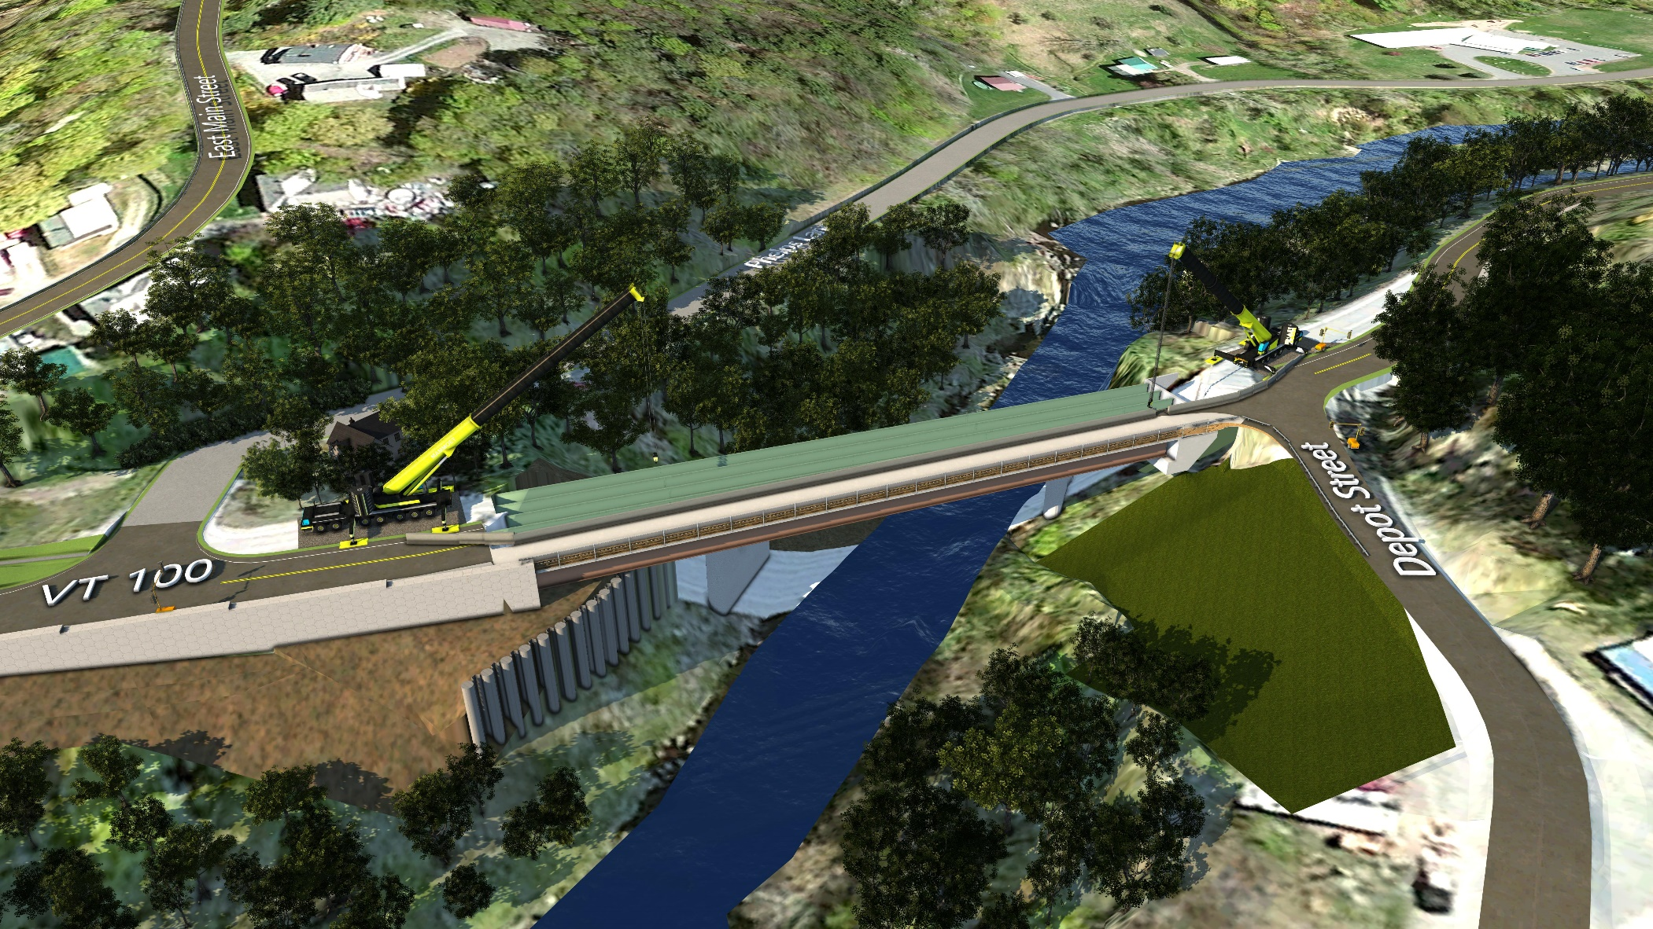
Traffic Control During Construction: PHASE 2 DEMOLITION

Slide 30
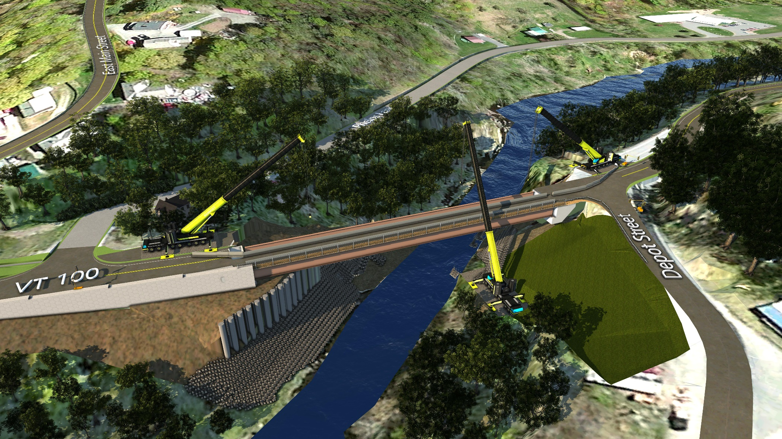
Traffic Control During Construction: PHASE 2A

Slide 31
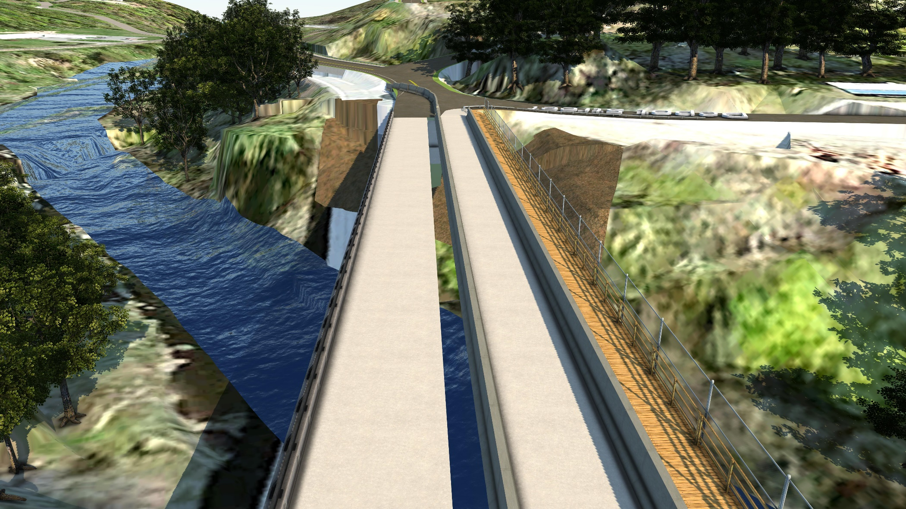
Traffic Control During Construction: PHASE 2B

Slide 32
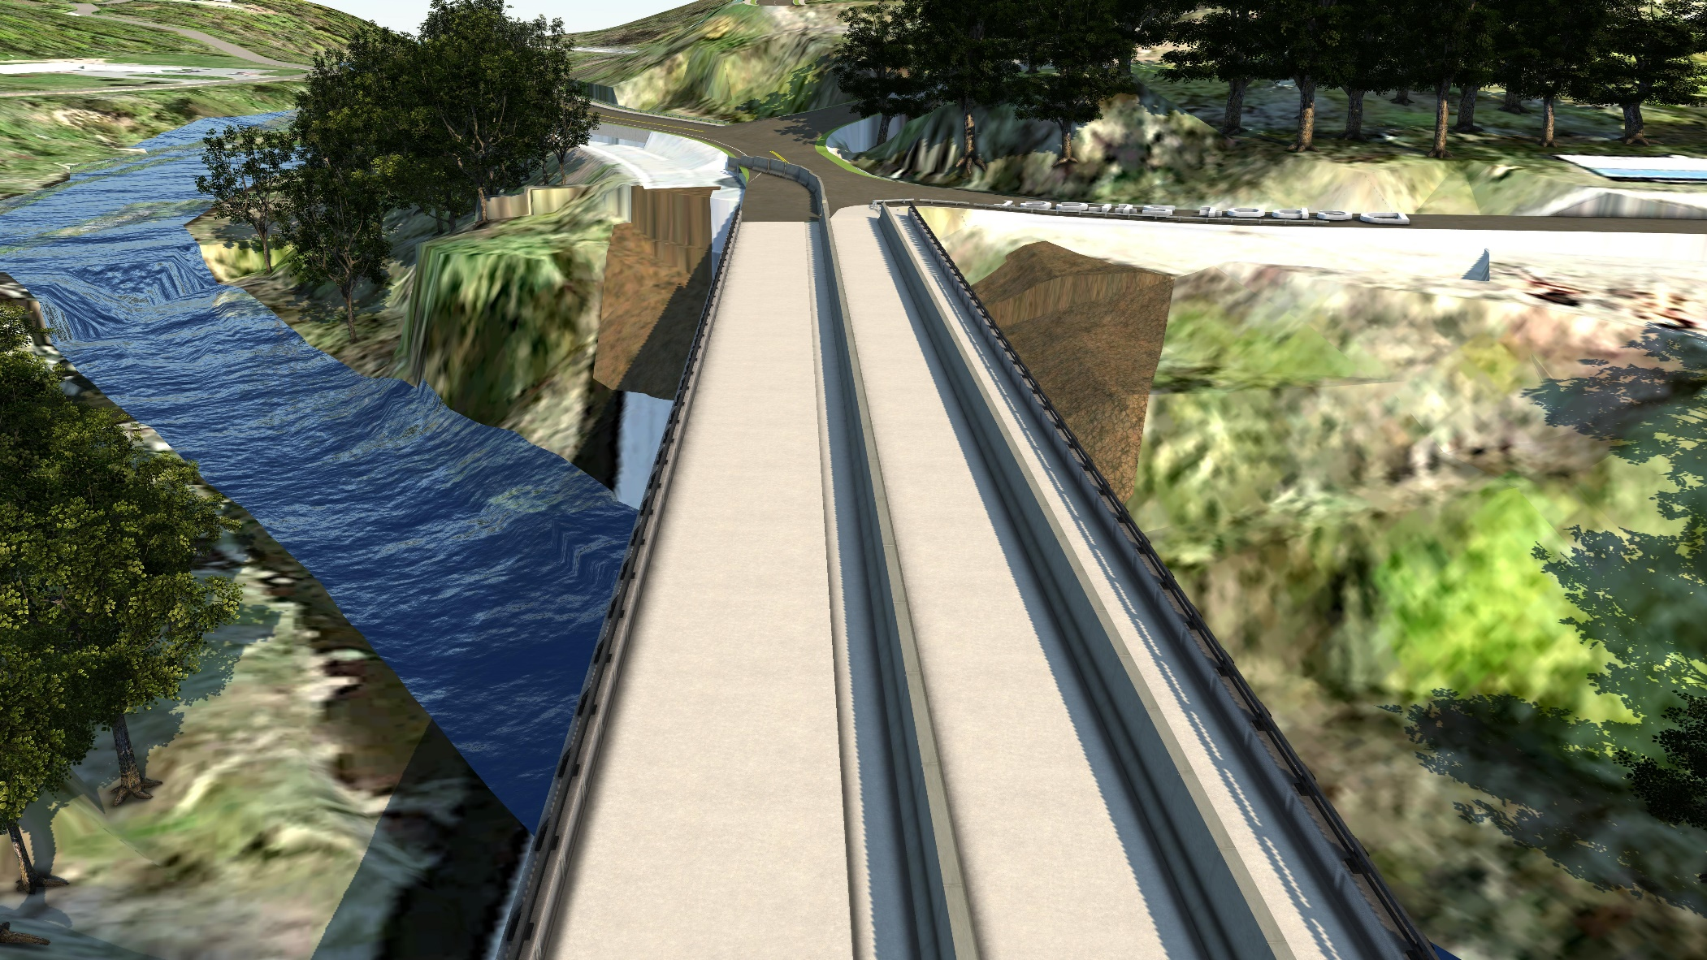
Traffic Control During Construction: PHASE 2B

Slide 33
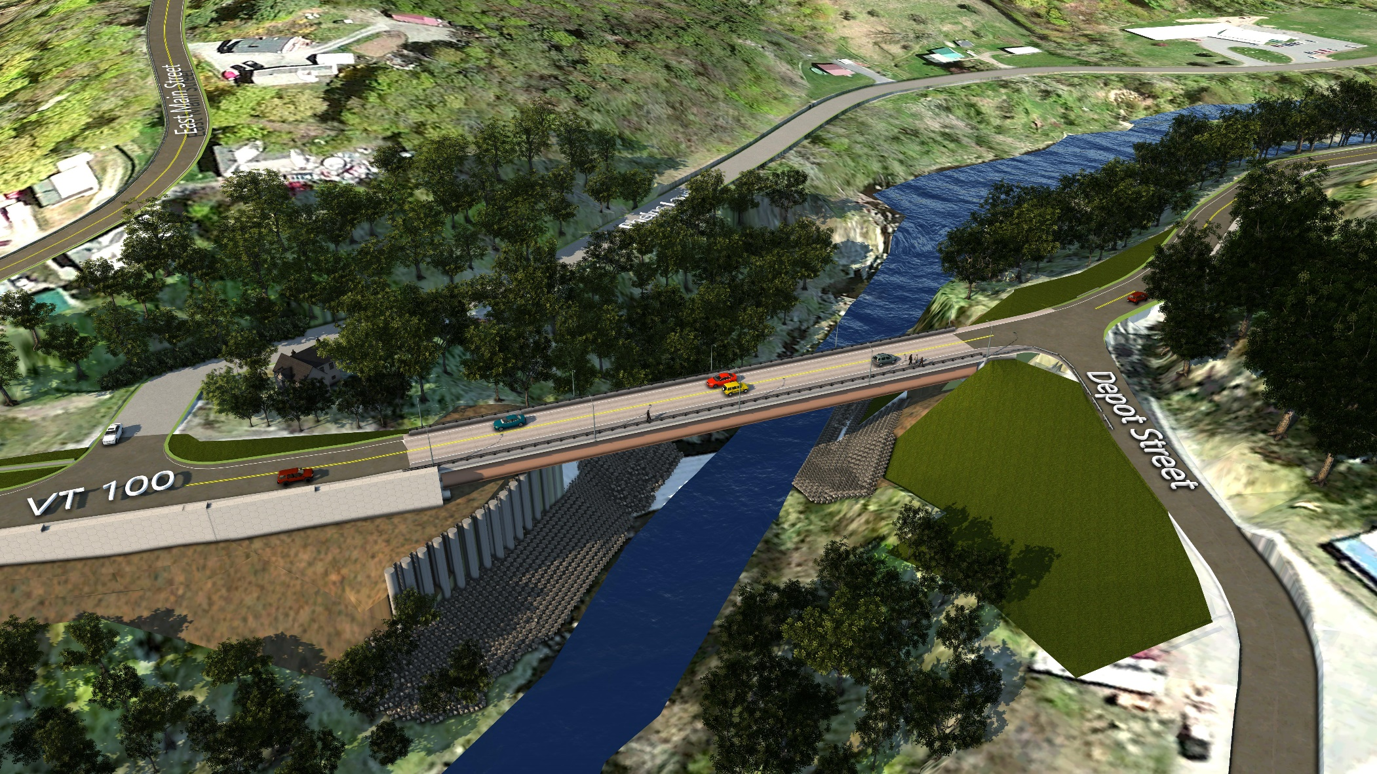
Traffic Control During Construction: PHASE 2C

Slide 34
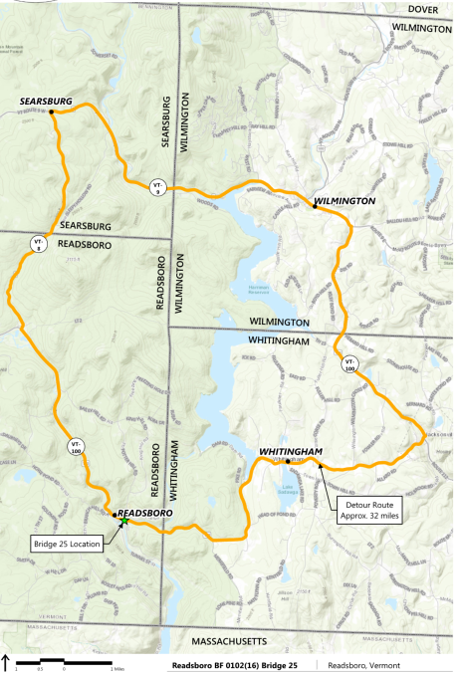
Traffic Control- Detour

Slide 35
Traffic Control-Detour
Considerations:
Access to Emergency Services
Mutual Aid
Alternate Location for Ambulance/Fire Truck on East Side of Bridge
Access to Hospitals in Bennington & Brattleboro
Coordination will be made with Town Events

Slide 36
Schedule
Preliminary Plans & Permitting – Winter 2017 to Spring 2018
Final Design – Summer 2018 to Spring 2019
Right-of-Way Complete – Fall 2018
Bid Advertisement – Fall 2020
Contract Award – Winter 2020
Construction – Sequenced throughout 2021 and 2022

Slide 37
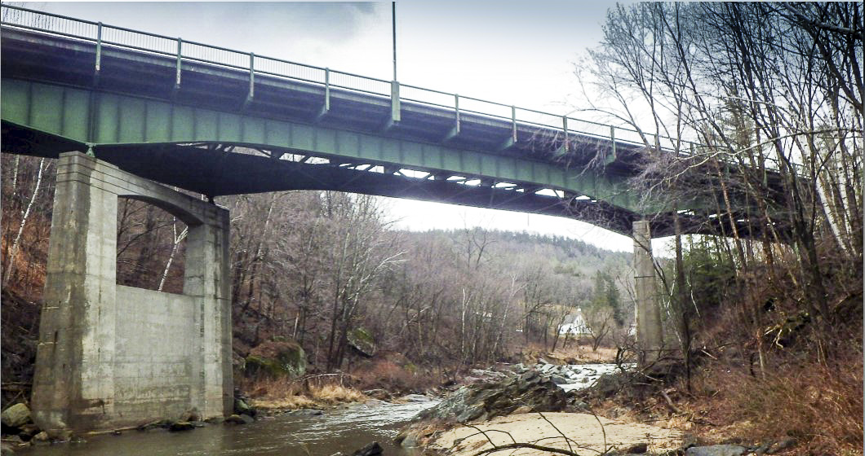
Thank You. Questions or Comments?

